Slide 1

SRM INSTITUTE OF SCIENCE AND TECHNOLOGY Ramapuram, Chennai – 600 089 DEPARTMENT OF COMPUTER SCIENCE AND ENGINEERING
18CSP109L-MAJOR PROJECT
A systematic Literature review on blockchain based academic certificate verification
Batch Number:7
Team Members | Supervisor
PUGAZHOLI R - RA2011003020113 HARISH S - RA2011003020136 KIRUBAKARAN J - RA2011003020170 | NAME : Dr.M.Mahasree

Slide 2
ABSTRACT
This project aims to develop a cutting-edge blockchain solution for securely verifying academic certificates.
By leveraging blockchain technology, the system will ensure the integrity and authenticity of academic credentials,benefiting parties such as universities,students and verifying agencies.

Slide 3
Scope and Motivation
The scope of this project encompasses the design and implementation of a blockchain-based platform for academic certificate verification.
The motivation behind this initiative is to combat certificate fraud and provide a reliable method for verifying academic achievements in a secure and tamper-proof manner.

Slide 4
Introduction
This project introduces the concept of leveraging blockchain technology to revolutionize the verification process of academic certificates.
By establishing a decentralized and transparent system, the project aims to enhance trust and efficiency in credential verification.

Slide 5
Literature Survey
S.No. | Title of the Paper | Year | Journal/Conference Name | Inferences
1) | A Systematic Literature Review on Blockchain-Based Systems for Academic Certificate Verification | 2023 | IEEE Access | This paper presents a systematic literature review on blockchain-based systems for academic certificate verification. The review highlights the key contributions, challenges, and future research directions.

Slide 6
Literature Survey
S.No. | Title of the Paper | Year | Journal/Conference Name | Inferences
2) | Blockchain-Based Academic Certificate Verification System—A Review | 2021 | Annals of Emerging Technologies in Computing | The review covers the design and evaluation of secure applications for certificate verification with the use of blockchain technology.

Slide 7
Literature survey
S.No. | Title of the Paper | Year | Journal/Conference Name | Inferences
3) | Verification of university student and graduate data using blockchain technology | 2021 | International Journal of Computers Communications & Control | This paper proposes a blockchain-based system for verifying university student and graduate data. The system allows for decentralized and distributed storage of certificates and incorporates a user-friendly Interface

Slide 8
Literature survey
S.No. | Title of the Paper | Year | Journal/Conference Name | Inferences
4) | Analysis of blockchain technology for higher education | 2019 | International Conference on Cyber-Enabled Distributed Computing and Knowledge Discovery | This paper analyzes the potential of blockchain technology for higher education. The paper discusses the benefits of using blockchain for academic certificate verification, including tamper-proof and non-repudiable electronic certificates

Slide 9
Literature survey
S.No. | Title of the Paper | Year | Journal/Conference Name | Inferences
5) | Blockchain-Based Academic Certificate Verification: A Comparative Study | 2022 | International Journal of Advanced Computer Science and Applications | This paper presents a comparative study of different blockchain-based academic certificate verification systems. The study compares the features, security, and usability of different systems

Slide 10
Literature survey
S.No. | Title of the Paper | Year | Journal/Conference Name | Inferences
6) | Blockchain-Based Academic Certificate Verification: A Case study | 2021 | International Journal of Computer Science and Information Security | The study evaluates the system's effectiveness, security, and usability and provides insights into the challenges and opportunities of implementing blockchain in the education sector.

Slide 11
Literature survey
S.No. | Title of the Paper | Year | Journal/Conference Name | Inferences
7) | Blockchain-Based Academic Certificate Verification: A Survey | 2020 | International Journal of Advanced Research in Computer Science and Software Engineering | The survey covers the different types of blockchain systems used, the benefits and challenges of using blockchain for academic certificate verification, and the potential future directions of this technology in the education sector.

Slide 12
Literature survey
S.No. | Title of the Paper | Year | Journal/Conference Name | Inferences
8) | Blockchain-Based Academic Certificate Verification: An Exploratory Study | 2022 | International Journal of Computer Science and Network Security | The study examines the potential benefits and challenges of using blockchain for academic certificate verification and provides insights into the design and implementation of blockchain-based systems in the education sector.

Slide 13
Literature survey
S.No. | Title of the Paper | Year | Journal/Conference Name | Inferences
9) | Implementation of a Decentralized Blockchain-Based Diploma Verification System. | 2021 | Procedia Computer Science | The system uses smart contracts to verify diplomas and store them on the blockchain. The paper also discusses the advantages of using such a system over traditional methods of diploma verification

Slide 14
Literature survey
S.No. | Title of the Paper | Year | Journal/Conference Name | Inferences
10) | Design and Development of a Blockchain-Based Student Degree Verification | 2020 | International Journal of Computer Assisted Learning | The platform enables students to share their degrees securely and efficiently with prospective employers or educational institutions. The paper also discusses the challenges encountered during the development process and how they were addressed.

Slide 15
Literature survey
S.No. | Title of the Paper | Year | Journal/Conference Name | Inferences
11) | Review of Blockchain Technology Applications in Academic Certificate Verification Systems | 2022 | International Journal of Information Management | It analyzes the current trends, challenges, and opportunities in implementing blockchain.The paper discusses the potential impact of blockchain on enhancing the security, transparency, and efficiency of certificate verification.

Slide 16
Objective
The primary objective of this project is to create a secure and immutable platform for issuing, storing and verifying academic certificates using blockchain technology.
The system will streamline the verification process while ensuring data integrity.

Slide 17
Problem Statement
Traditional methods of certificate verification are vulnerable to fraud and manipulation, leading to issues like fake certificates.
This project addresses these challenges by implementing a blockchain solution that prevents unauthorized modifications and enhances trust in academic credentials.

Slide 18
Proposed Work
The proposed work involves developing a user-friendly interface for university administrators to upload student records, issuing certificates securely on the blockchain
converting certificates into tamper-proof tokens using advanced cryptographic techniques.

Slide 19
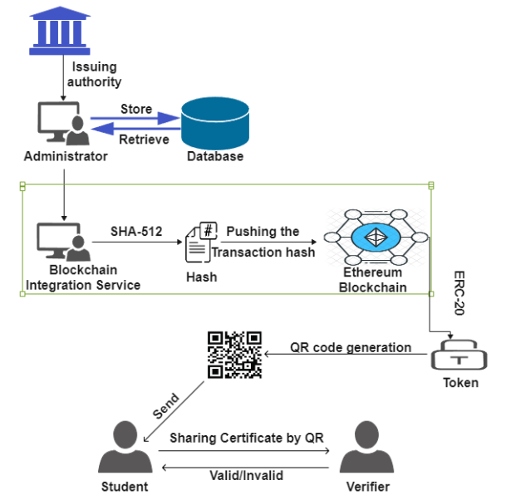
Architecture Diagram

Slide 20
Novel Idea
The innovative aspect of this project lies in utilizing blockchain technology to create an immutable ledger for academic certificates.
By combining cryptographic security with decentralized storage, the system offers a novel approach to certificate verification.

Slide 21
Modules
The blockchain-based academic certificate verification system comprises four distinct modules:
Module 1 : University administrator
Module 2 : Blockchain Integration Module
Module 3 : Student
Module 4 : Verifier
Each module plays a crucial role in maintaining the overall functionality of the system.

Slide 22
Module 1 : University Administrator
Stores student records and certificates in a centralized database.
Issues certificates based on records from the database.
Uploads certificates to the Blockchain Admin module.

Slide 23
Module 2 : Blockchain Integration
Converts certificates into hash values using the SHA-512 algorithm.
Pushes hashed certificates onto the Ethereum blockchain.
Generates unique tokens associated with each verified certificate.
The token can be transformed into either a QR code or a blockchain public URL.

Slide 24
Module 3 : Student
Allows students to access their certificates.
and displays their issued certificates to verifiers.
Students can able to share the certificates by QR code/Public URL.
Blockchain storage ensures permanent and secure certification validation for students, eliminating the need for paper copies.

Slide 25
Module 4 : Verifier
Uses QR codes or blockchain public URLs to validate certificate authenticity.
Scans QR codes or visits blockchain public URLs provided by the student.
Confirms the existence of the certificate on the Ethereum blockchain.

Slide 26
Software & Hardware Requirements
Software Requirements:
Database management system for storing student records.
Blockchain platform like Ethereum for token generation and verification.
Web application framework such as React for user interfaces.
Hardware Requirements:
Server infrastructure to host the database and blockchain platform.

Slide 27
Implementation
The goal of this project is to streamline the process of certificate generation and validation and ensure the integrity of the certificate by exploiting the transaction immutability property of blockchain. We will also store the digital PDF copy of the certificate on IPFS to make it easily accessible.
The tech stack for this entire project includes:
Ganache-cli: As the local blockchain network
Truffle: For smart contract development and deployment
Streamlit: For developing the web application
Pinata: As an IPFS client
Docker: To containerize the entire application into different services

Slide 28
Implementation
The system comprises of 2 main entities:
Institute: Responsible for generating and issuing certificates. Has the functionality to generate and view certificates.
Verifier: Responsible for verifying certificates. Has the functionality to verify certificates by either uploading a certificate pdf or by inputting the certificate id.

Slide 29
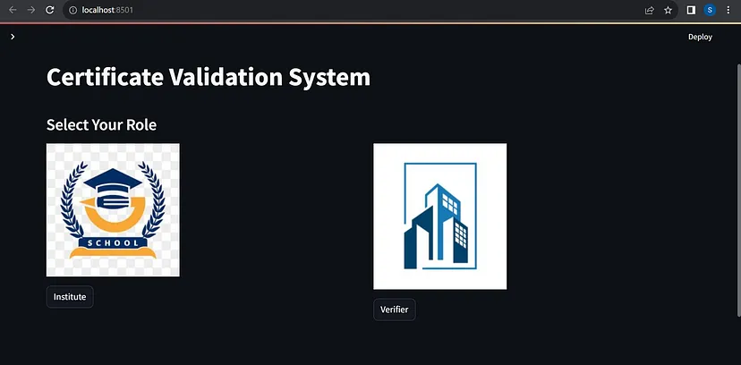
Intermediate results

Slide 30
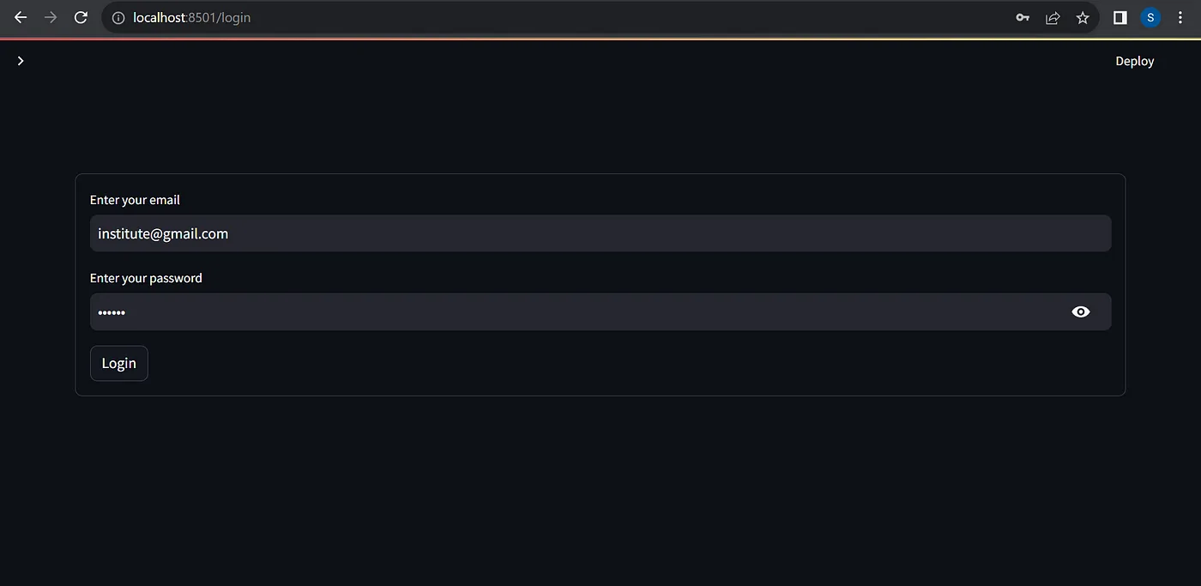
Intermediate results

Slide 31
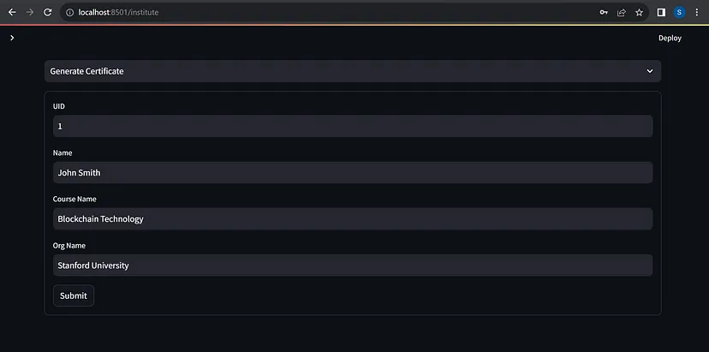
Intermediate results

Slide 32
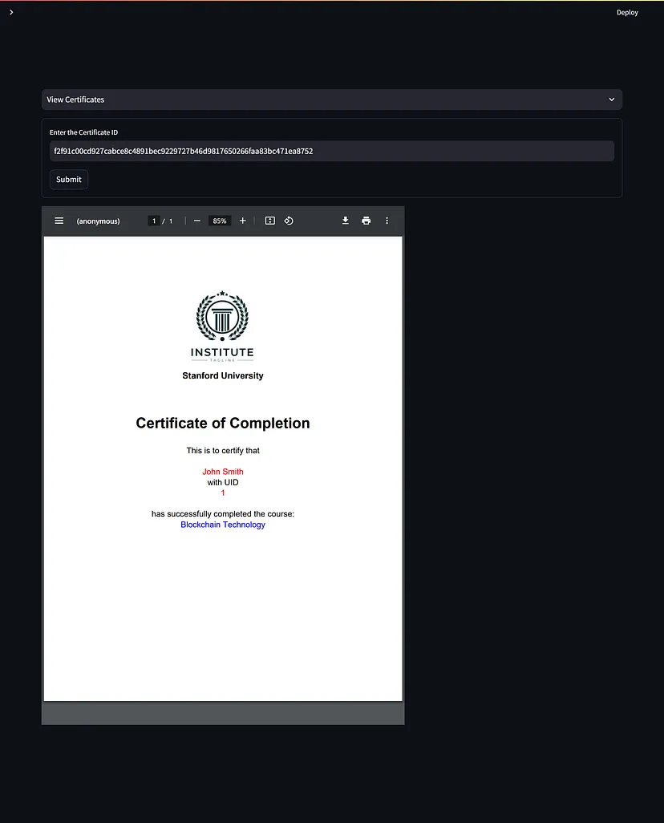
Intermediate results

Slide 33
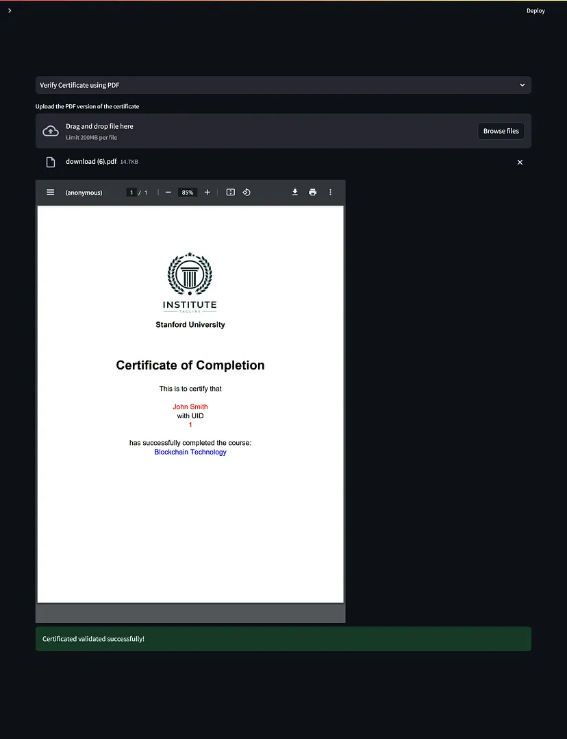
Intermediate results

Slide 34
References
"Blockchain in Education: A Systematic Review and Practical Case Studies" - IEEE paper
"Blockchain Technology Applications in Higher Education" by Adeyemi O. Olukotun.
"A Blockchain Based System for Secure Academic Certificate Verification" by S. Kaur et al.
"Design and Implementation of a Decentralized Credentials Management Framework Using Blockchain Technology" by Md. Mahbubul Alam et al.
"Trustworthy Digital Diploma with Blockchain Technology" by Yongjin Kim et al.
"Towards a Blockchain-Based Solution for Authenticating Educational Qualifications" by Rashmi Singh et al.
"Exploring the Potential of Blockchain Technology in Enhancing the Integrity of University Degrees" by Mohammad Ahmadi et al.

Slide 35
Outcome
By integrating blockchain technology, this system prevents the creation of fake certificates and offers an enhanced level of trust when verifying academic credentials.
It also helps organizations combat fraudulent practices and maintain transparency throughout the certification process

